Slide 1

GESTIONE TRASFERTE
(otherwise know as E-TRAVEL)
Step-by-step instructions for trip (missioni) authorizations
Target: Cognitive and Brain Sciences PhD students
2025

Slide 2

Research activities carried out in Italy or abroad - 1
Before heading off to a research meeting/conference/summer school PhD students must ALWAYS ask for the authorization from their supervisor AND fill out authorization request in E-travel, for the following reasons:
insurance coverage (if you do not follow the procedure you won’t be covered by accidental insurance of the University);
to notify the relevant offices of your absence;
to be reimbursed (where applicable).
These rules are valid for the entire duration of your PhD, from your start date until your PhD thesis discussion.
Please note: no reimbursements allowed if the destination of your trip coincides with the municipality where you have your official residence.
If the research activity is abroad for ≥ 1 mo. remember that you are eligible for a 50% grant increase (https://www.unitn.it/en/node/2004). For periods abroad lasting 3 months or more, you can get 60% of the 50% grant increase in advance (advance payment).
At least 4 weeks before departure or payment of conference registration, you must request your Supervisor’s approval (see Supervisor approval instructions step). Then you may enter an online travel authorization request (Gestione Trasferte/E-travel). If the stay is longer than 3 days you can ask for an advance payment of the estimated costs concerning food, lodging and travel. A maximum of 75% of the total amount will be paid out by sending the request at least 10 days before the start of the trip, so that the advance is paid before departure. Should you be in your 4th year you may only get 50% advance on what you declare in the advance payment section of the travel authorization request.

Slide 3

Research activities carried out in Italy or abroad - 2
Trip authorizations cannot be granted retroactively. You will not be reimbursed if the Travel Authorization Request is not entered before your departure and you will not be granted insurance in case of an accident.
The online Travel Reimbursement Liquidazione form and original receipts must be delivered within 30 days after you return from the trip. Submit your Travel Reimbursement Request by clicking on the ‘L’ next to your pre-authorized trip in Gestione Trasferte/E-travel, and mail the original receipts to Servizi Amministrativi Contabili – Rovereto, Palazzo Piomarta.
Eligible expenses to be claimed via Gestione Trasferte/E-travel are travel, lodging and meals. PhD students should use the cheapest possible means of transportation (i.e. economy class tickets). Lodging receipts must be in your name in order to be reimbursed. If you share your lodging, please ask for a separate receipt in your name. In the case of accommodation in an apartment (Airbnb), economic efficiency must be demonstrated by attaching an estimate of the cost of accommodation in a nearby hotel.
In case of early departure or postponed return, refunds of any kind are not allowed except for the cost of the trip. It is up to the interested party to present adequate documentation for the economic comparison of travel costs on the two dates. The Administration will proceed to reimburse the lower cost. In the absence of such evidence, the reimbursement is not admissible. The documentation for the comparison must be requested when booking the tickets in order to make the costs comparable. No other reimbursements are allowed (meals, overnight stay, local transport, etc.) on extension and/or advance days.

Slide 4
Research activities carried out in Italy or abroad - 3
TO DO
Before leaving: should you have any doubts check in with Leah and read the Regolamento per le missioni (in particular, the maximum expenses allowed for PhD students) carefully. Then, the Travel Authorization Request (“Richiesta Autorizzazione Missione”) must be submitted using the online “Authorization” form (login to your personal account “MyUnitn” and click on “E-travel”) and send for approval by the Center’s Director.
The online Travel Authorization Request must be filled out even in case of travels without reimbursement (for example, the trip is funded by external institutions). In this case, you have to check the field “I don’t ask any reimbursement for this travel.” In case of cancellation/postponement of the trip (after you filled out the online form), you must delete the Travel Authorization Request.
During the trip: keep all the original tickets, receipts, invoices, boarding passes, etc. Credit card slips do not count as receipts!!! Just the ricevuta parlante counts for reimbursement, meaning the receipt with the itemized costs.
Upon return: within 30 days after returning fill out the Travel Reimbursement Request/“Richiesta Liquidazione Missione” online (with the description of the costs). Deliver the original documents (receipts, etc.) to Servizi amministrativi – contabili di Polo. In case of reimbursements exceeding € 77,47, an amount of € 2,00 will be deducted due to legal stamp duties.

Slide 5

How to complete the Travel Authorization Request
The «Travel Authorization Request» in the Gestione Trasferte/E-travel needs to be complete and detailed, because some data of the trips of PhD students for each a.y. are requested for statistical purposes by the Ministry of Education, University and Research (M.I.U.R.) and by the Italian Evaluation Agency (ANVUR). Therefore you must stick to the following instructions to fill out your Travel Authorization Request correctly.
1. Login to My UNITN
2. Locate the Gestione trasferte (E-travel) widget and click on it.

Slide 6
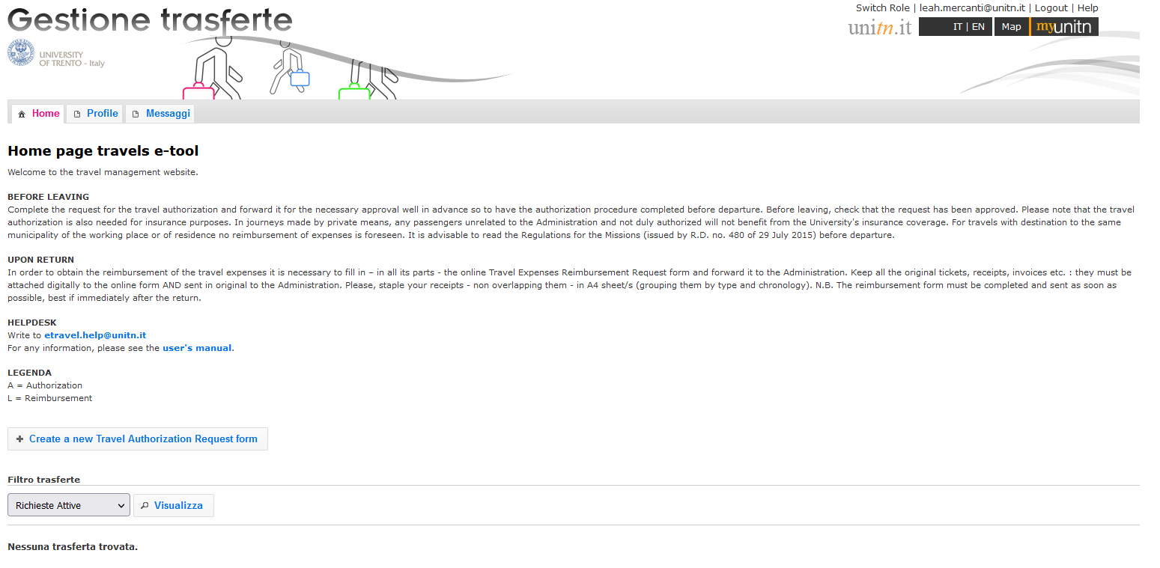
How to complete the online
Travel Authorization Request
Create a new Travel Authorization Request

Slide 7
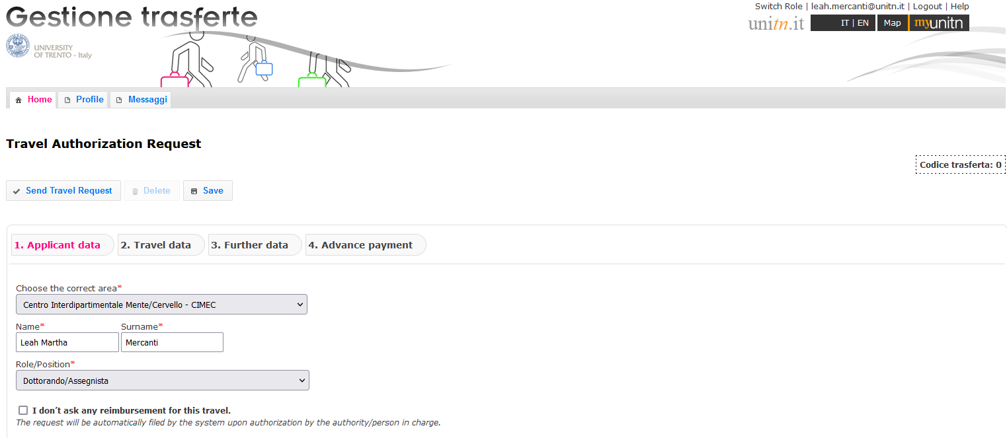
APPLICANT DATA > ROLE/POSITION
Select your role/position
(Dottorando/Assegnista)

Slide 8
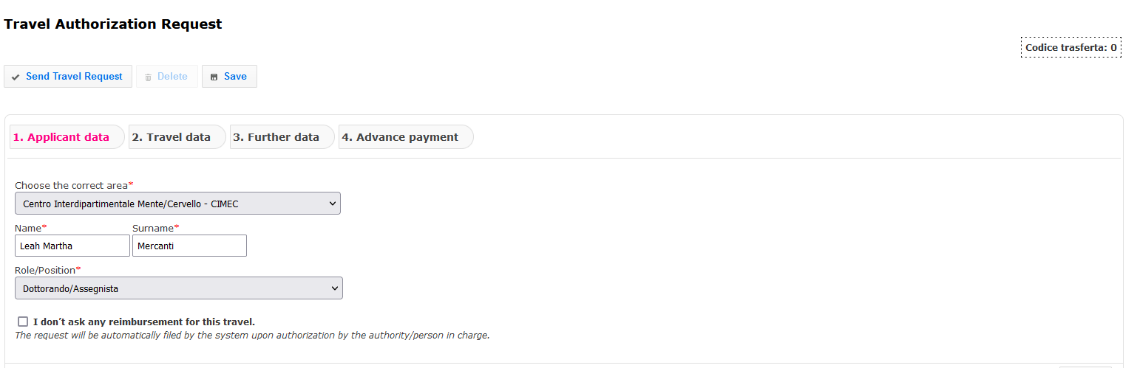
APPLICANT DATA > REIMBURSEMENT
Specify if you are not interested in the reimbursement so Accounting know you are only filling it out for insurance coverage purposes

Slide 9
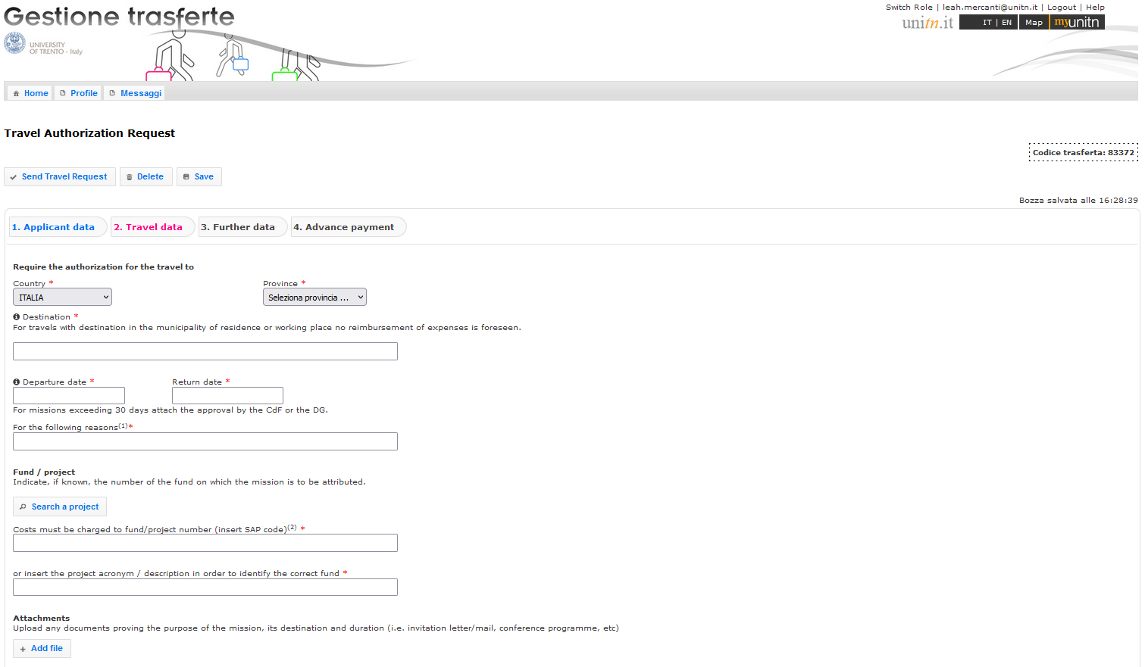
ITALY
Italian Province: choose in the list; enter the city (address, number etc. is not needed)
The list includes all the Italian provinces. The Province is the main town of an administrative district.
Examples: Pergine is in the Province of Trento; Erice in the Province of Trapani.

Slide 10
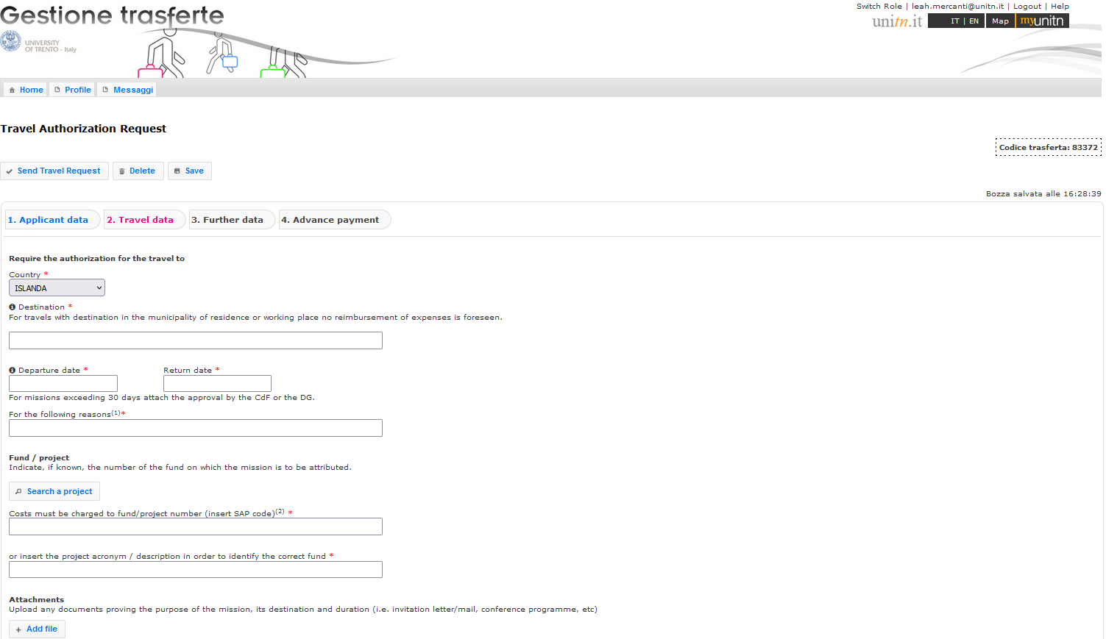
ABROAD
Choose a country from the list
(in Italian)

Slide 11
«Destination» field
1) Remember! You cannot ask for reimbursement if the destination of your mobility is in the municipality where you have your official residence.
2) Fill in the box as follows: CITY – INSTITUTION
Examples:
Roma – Università «La Sapienza»
Berlin – Freie Unviersitaet Berlin
Paris – CNRS Centre national de la recherche scientifique
Verona – Azienda Ospedaliera di Borgo Trento
Torino – FCA Fiat Crysler Automobili
Milano - Politecnico
Specify the official and complete name, in original language, of the hosting institution.
In case of Conferences, Summer schools, Workshops etc., if the hosting institution/location is different from the organizing institution, write the organizing institution instead. Example: Erice – Associazione Internazionale di Astrofisica - Convegno di astrofisica 2008

Slide 12
«Dates» field
The start and return dates MUST refer to the actual dates you leave and return (for insurance purposes) from Trento/Povo/Rovereto.
If you leave in advance (or return later) for personal reasons with respect to the period of mobility referred to, you must specify it in the box «For the following reasons».
Example: EUREGIO – Conference «Borders beyond borders» - The days 23-25 april I will remain for personal reasons.

Slide 13
«For the following reasons» field
Clearly specify the motivation.
International Mobility Programmes:
Erasmus+ Study
Erasmus+ Traineeship
Erasmus Mundus Joint Doctorate (SMART, IDEALAB)
Marie Sklodowska-Curie Action
Horizon2020 Actions
International Credit Mobility-ICM
EIT
co-tutelle de these
Collège de France
bilateral agreement
ITPAR
other (specify)
Research activites:
free mover
visiting PhD student
internship at research labs or institutions
summer/winter school
seminar-conference-workshop-symposium
partecipation to research programmes or projects (PRIN, FIRB, …)
other (specify)
Examples:
Conference « IDRAPOWER 2018» and poster presentation
Summer School «Maths on the rocks»
Research period at the Experimental laboratory
Field research /Ricerca su campo / Ricerca in azienda
Stage/Internship hospital such and such NYC
In case of a mobility within a specific project ALWAYS quote it as the first information.
Examples:
EUREGIO – Conference «Borders beyond borders»
ERASMUS+ – Mobility research period at the partner institution
MSCA – Mandatory secondment to the partner organization
PRIN – riunione per presentazione risultati
CO-TUTELA DI TESI – Research period at the partner institution
H2020 – EUROFLOW project – Kick-off meeting
Bottom line: there’s no such thing as putting too much information in this field!

Slide 14
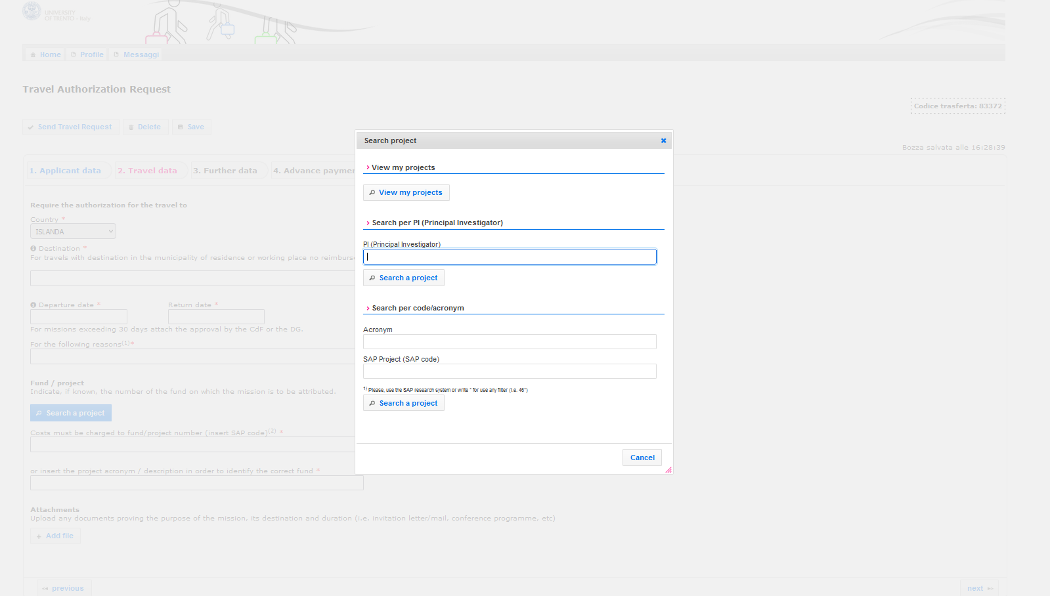
«Fund/Project» field
2.a. View my projects
OR
2.b. Name of supervisor
2.c. Fund number
1. Search a project

Slide 15
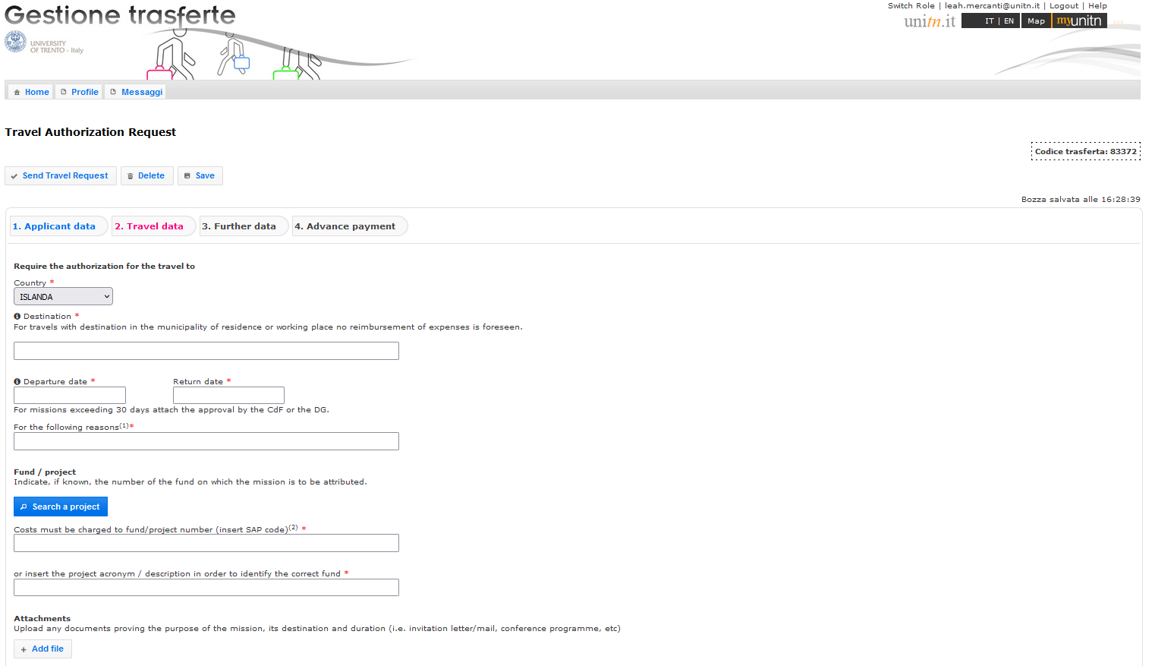
«Attachments» field
Always upload the Conference programme, invitation letter/email, the link or pdf of the Conference/School program you are going to attend

Slide 16
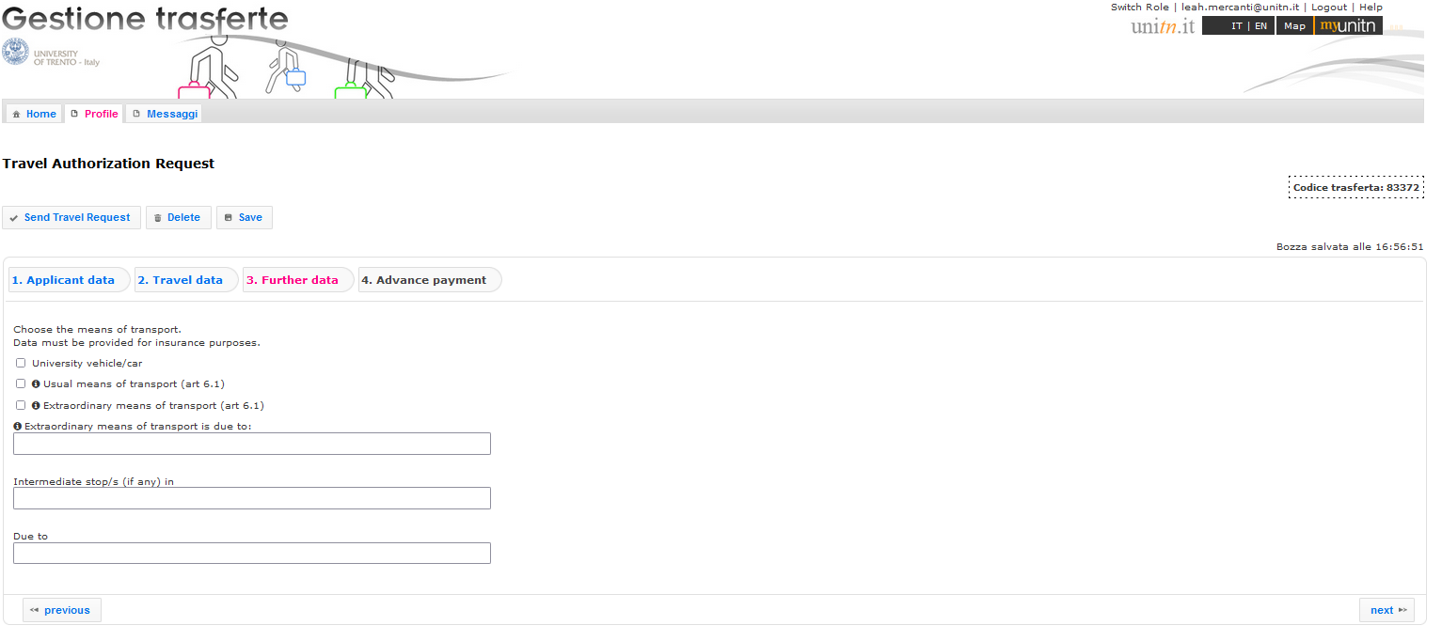
«Means» field
Usual means: train, bus, airplane, car up to km 700 (including return trip)
In case of car-sharing specify the names of other students/professors coming with you in the Extraordinary means box

Slide 17
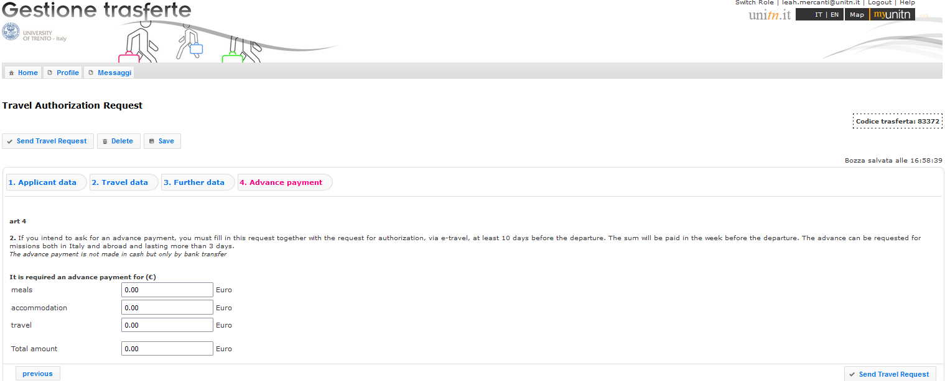
«Advance payment» field
Specify the type of expense (train/airplane ticket, hotel room…)
Last step: Send request to address in next page

Slide 18
Useful contacts - resources
Accounting Rovereto (Presidio Amministrativo Contabile)
Corso Bettini, 84, Rovereto, 38068 Trento
(Palazzo Piomarta)
Tel. +39 0464 808435 (E. Baldessari) – 8453 (M. Simonetti)
– 8437 (A. Rossaro)
serv.amm.cont.rovereto@unitn.it
For 50% increase for periods greater than 1 month:
Humanities and Cognitive Sciences Area - PhD Office
Via Verdi, 26 - 38122 Trento
Ph. +39 0461 28 2188 -1753 - 2193 - 3232
Fax +39 0461 282191
phd.office-cssh@unitn.it
Office opening hours: from Monday to Friday: 10:00-12:00 a.m.; Tuesdays: 14.00:16.00 p.m.
https://wiki.cimec.unitn.it

